Slide 1
In Drive Coupon Recommendation
Presented By – Meghraj Konduskar

Slide 2

Problem Statement
This data was collected via a survey on the Ecom website Mechanical Turk. The survey describes different driving scenarios including the user’s destination, weather, passenger, coupon attributes, user attributes, and contextual attributes, and then asks the user whether he/she will accept the coupon or not. In this project we have to predict if the user will accept the coupon.
This is a supervised machine learning classification problem.

Slide 3
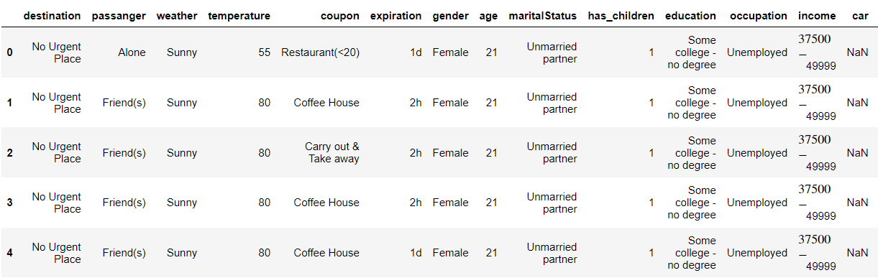

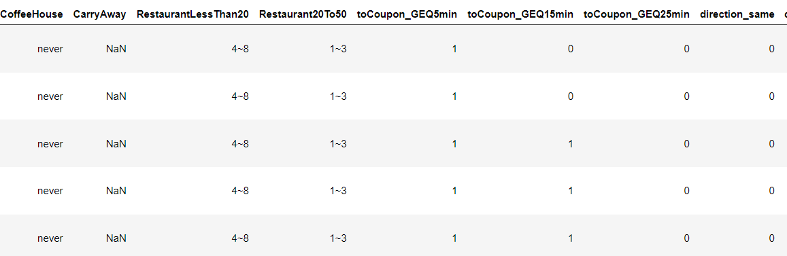
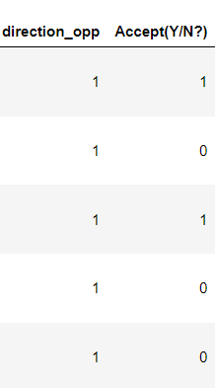
Overview of Dataset.
We have 24 variables and 12684 observations in our dataset.

Slide 4
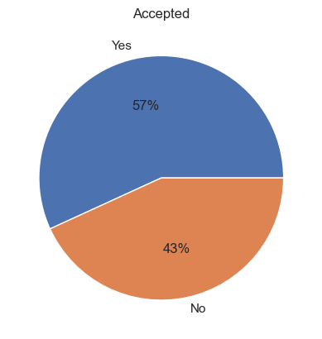
Target Variable (Accepted)
“accepted” is our target variable which contains 1 or 0 for Yes or No. Whether the user has accepted the coupon or not.
We have 7210 observations as “Yes” and 5474 observations as No
Since data is fairly balanced I chose Accuracy Score as evaluation metric

Slide 5
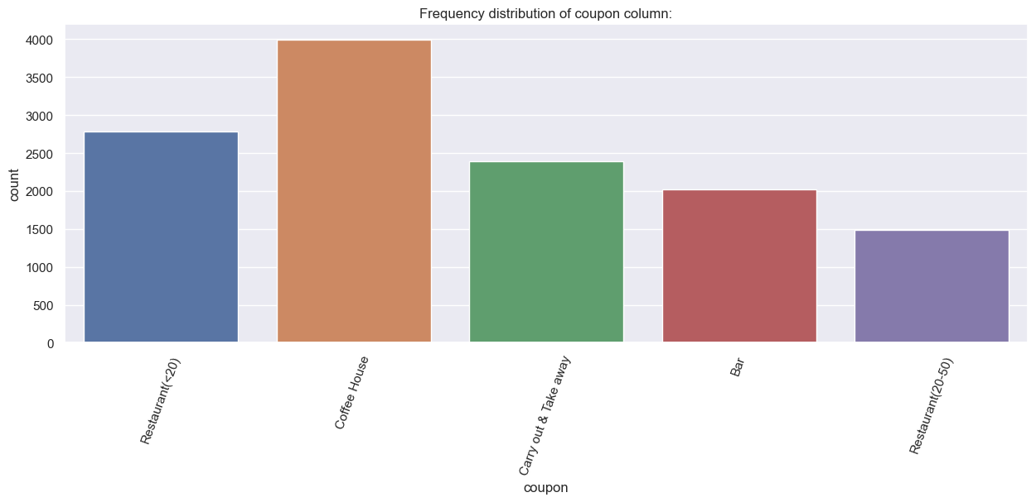
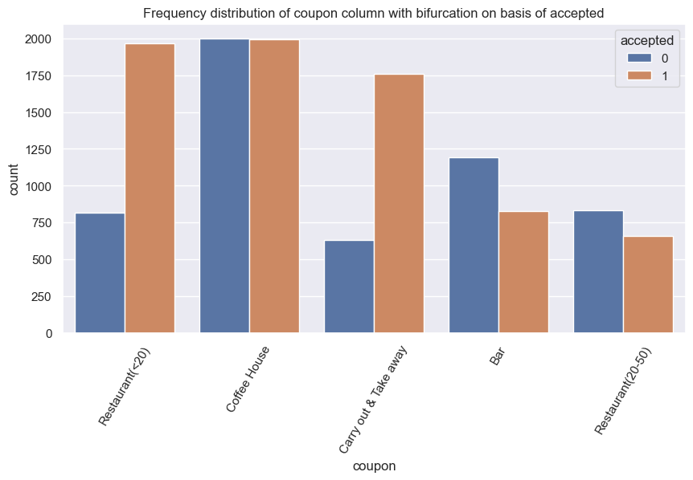
Which type of coupons are available?
Carryout and Takeaway coupons and when the Restaurant coupons average expense of customer is less than $20. Customer is more likely to accept these coupons.
We can see when the coupon is for Bar and Restaurant between $20 - $50. These coupons are getting rejected more often
Whereas Coffee house coupons are 50-50 split
Used One Hot Encoding for coupons

Slide 6
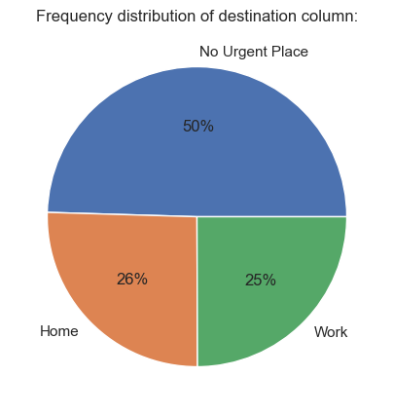
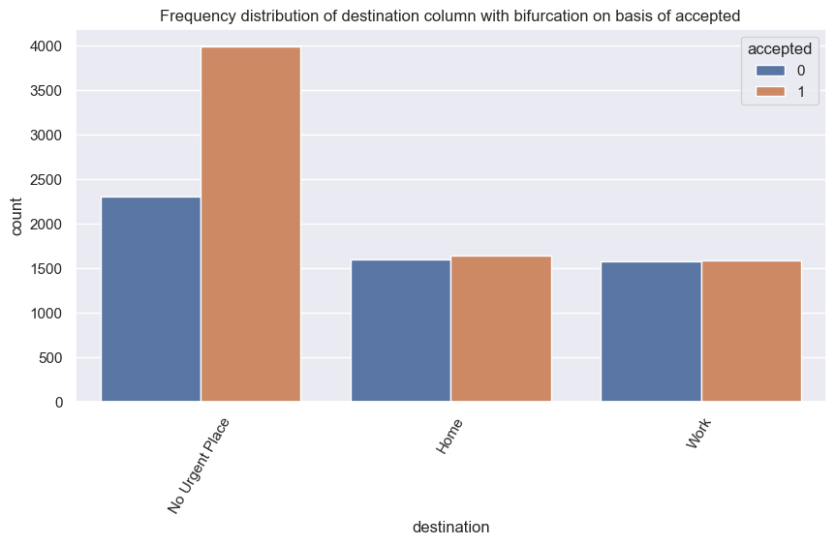
Destination
When customer is not in a hurry to go to any urgent place. He/She is more likely to accept the coupon.
Used One-Hot encoding for this feature.

Slide 7
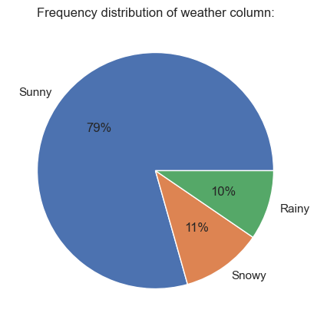
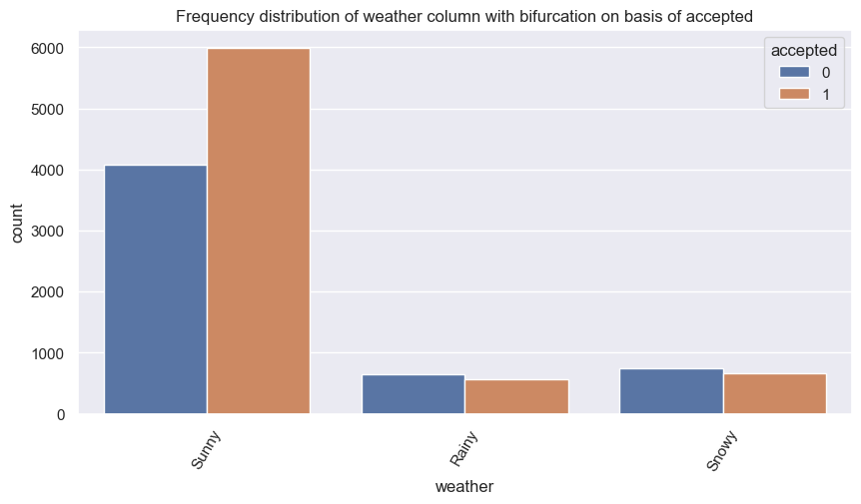
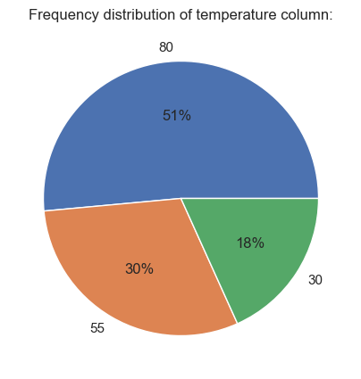
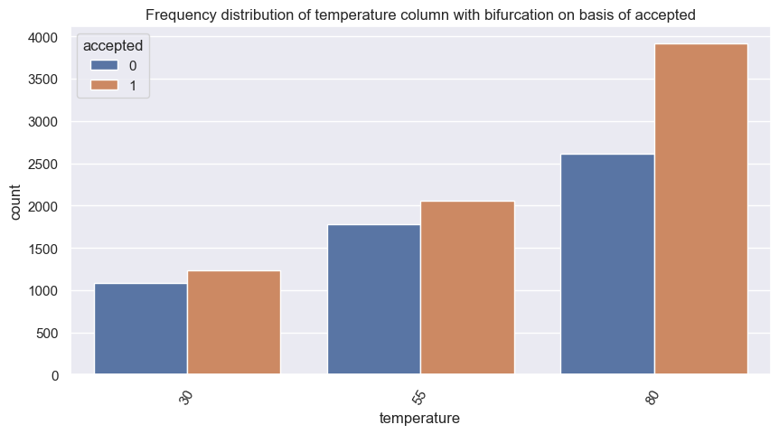
Weather and Temperature
When the weather is sunny and temperature is high, customer is more likely to accept the coupon. And we can see when the weather is rainy or snowy the customer is more likely to reject the coupons.
Temperature is a numeric feature but with only 3 distinct values.

Slide 8
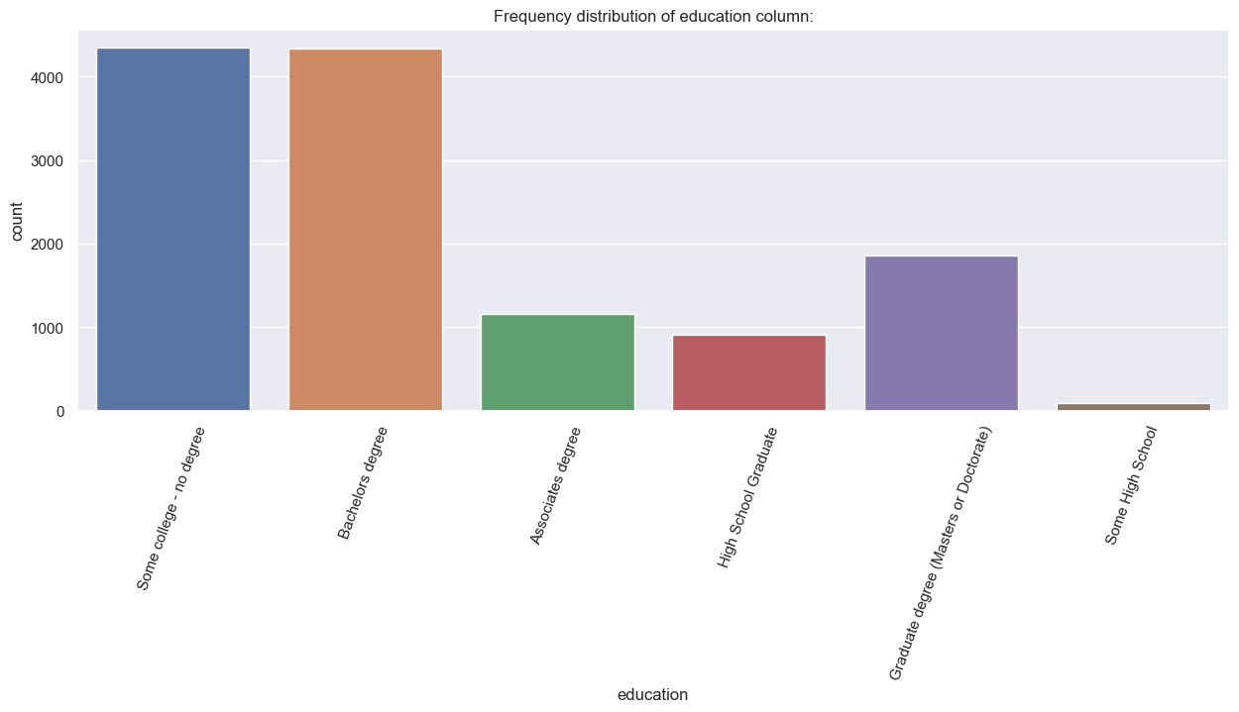
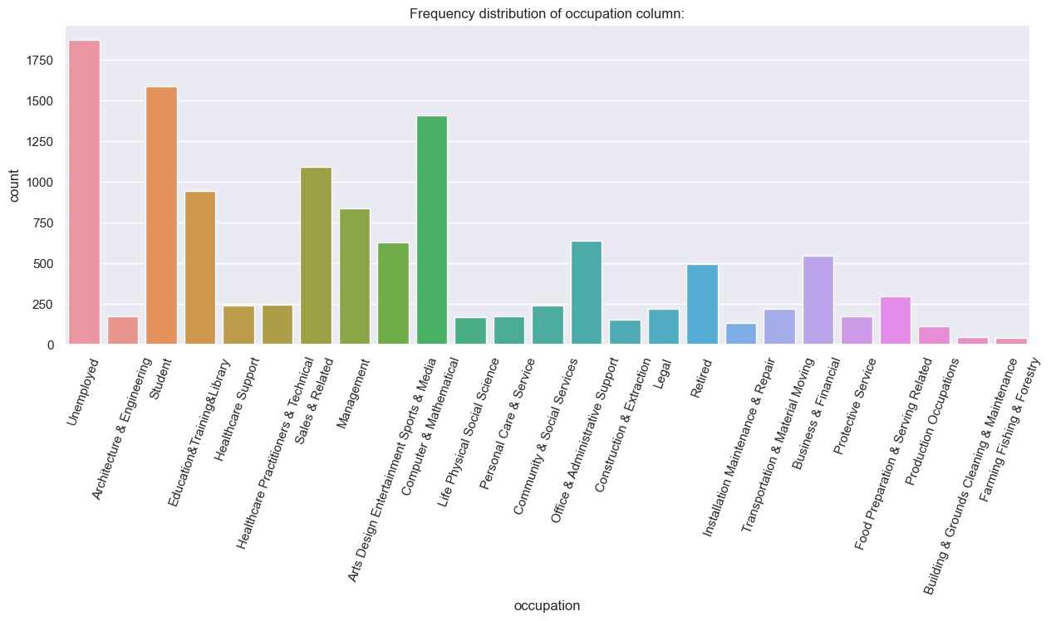
Education & Occupation
We have 6 categories in education.
I have used label encoder in order: Graduate(Masters) > Bachelor > Associate > College > High School Graduate > Some High School
We have 25 categories in occupation.
We should not use label encoder because we can’t say that one occupation is better than other.
I have merged all customers who are employed into one “Employed” category, to minimize the dimensions after one-hot encoding.

Slide 9
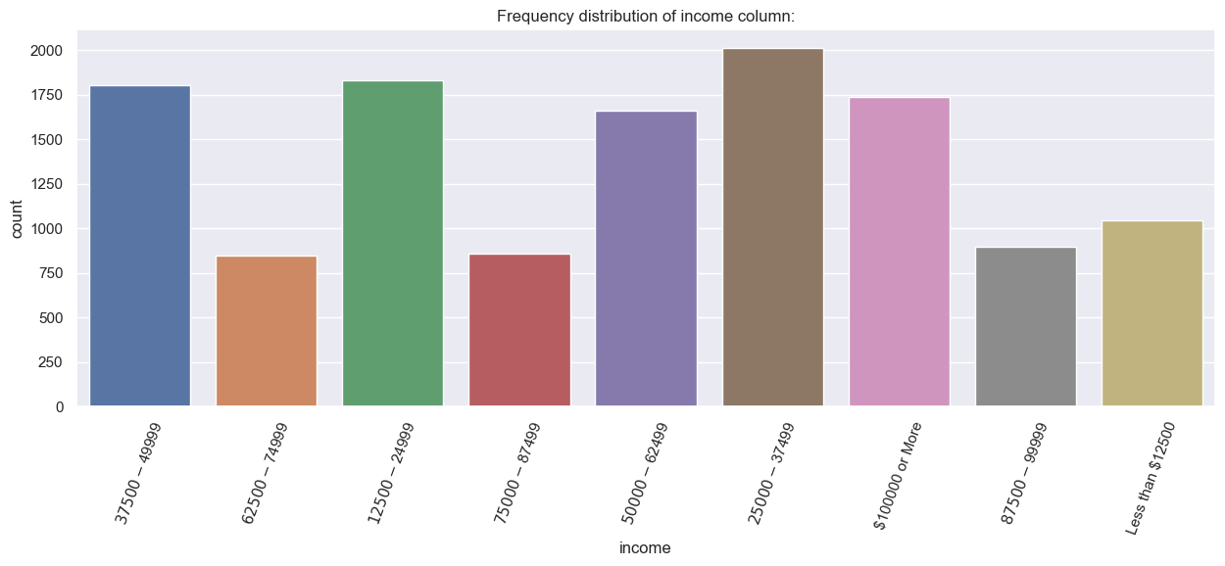
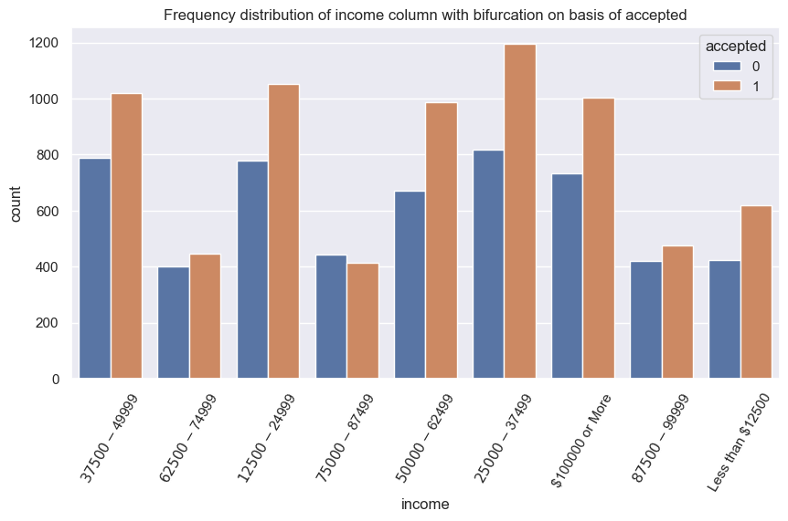
Income
We have 9 categories of income starting from customers earing less than $12500 to more than $100000
Acceptance ratio of majority of the income category is high except the customers falling in $75000 - $87499 income range.
I have used Label encoding starting from less than $12500 as 0.

Slide 10
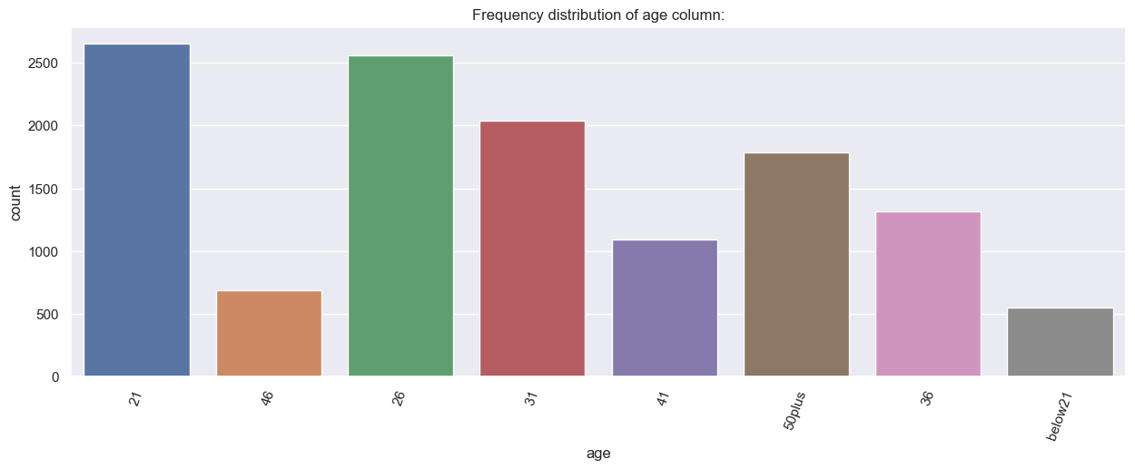
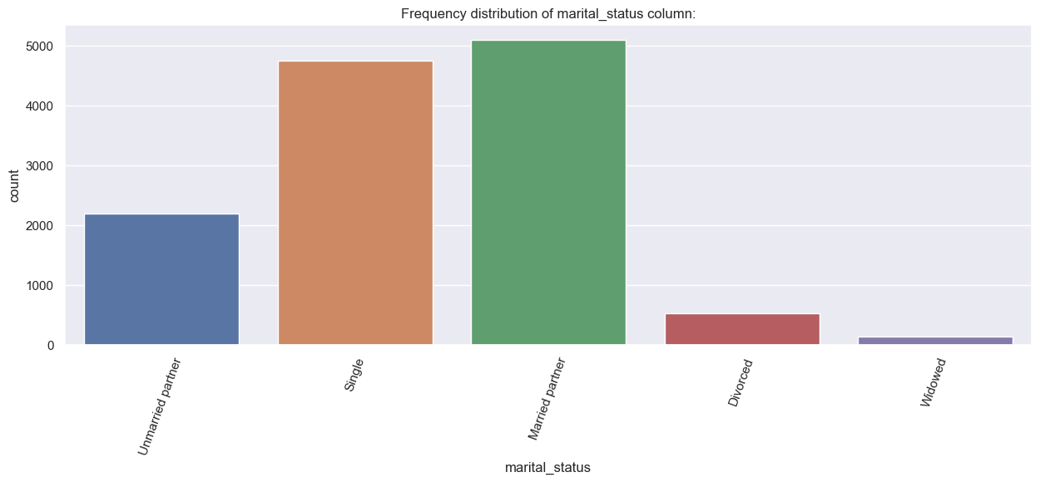
Age & Marital Status
We have 8 categories of Age. And it is stored as string data.
I considered below 21 as 20 and 50plus as 51 and converted this feature into numeric.
We have 5 categories of Marital Status.
I used One-Hot Encoding for this feature

Slide 11
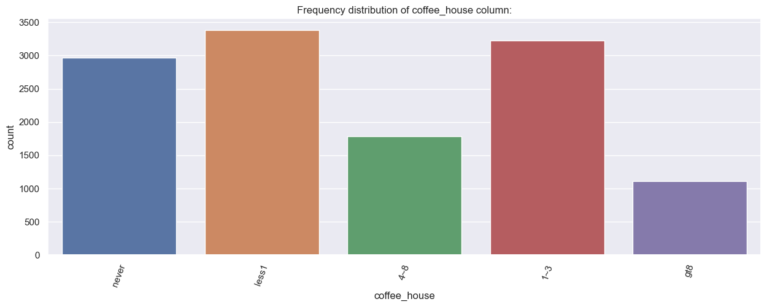
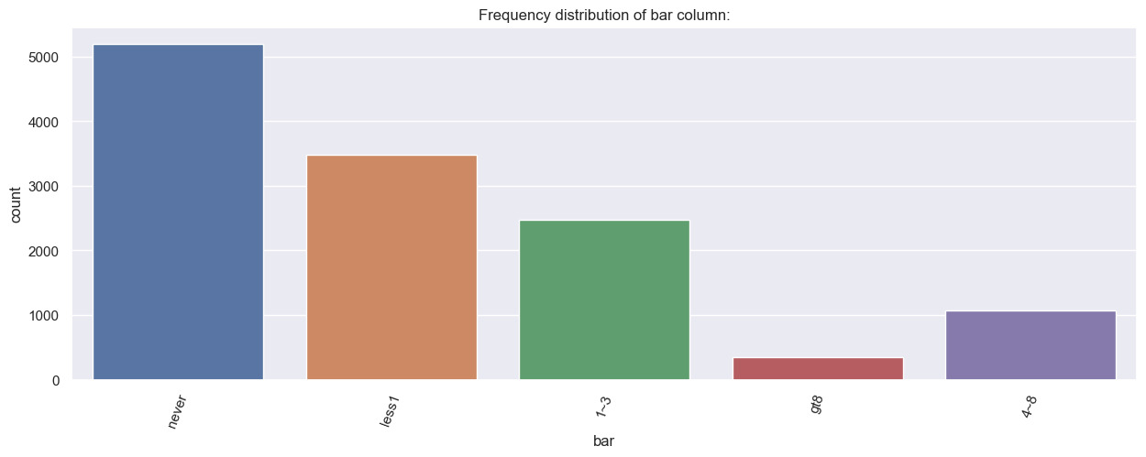
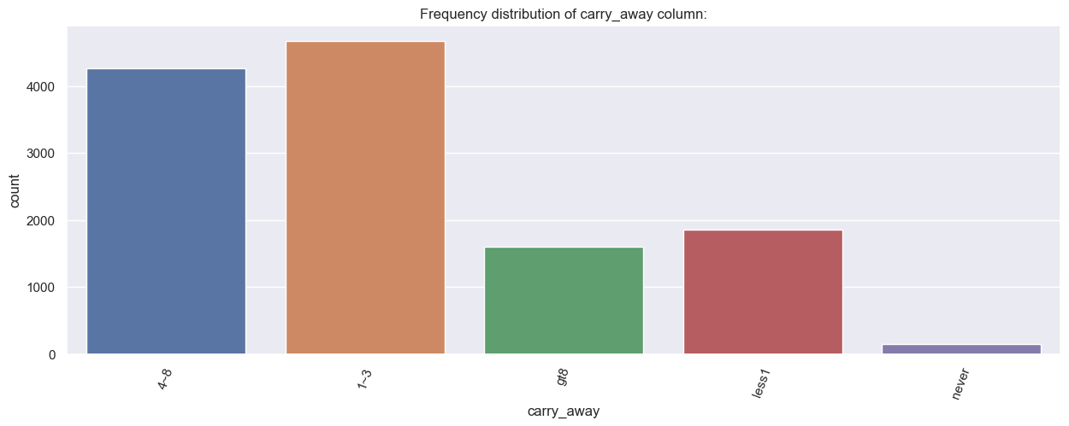
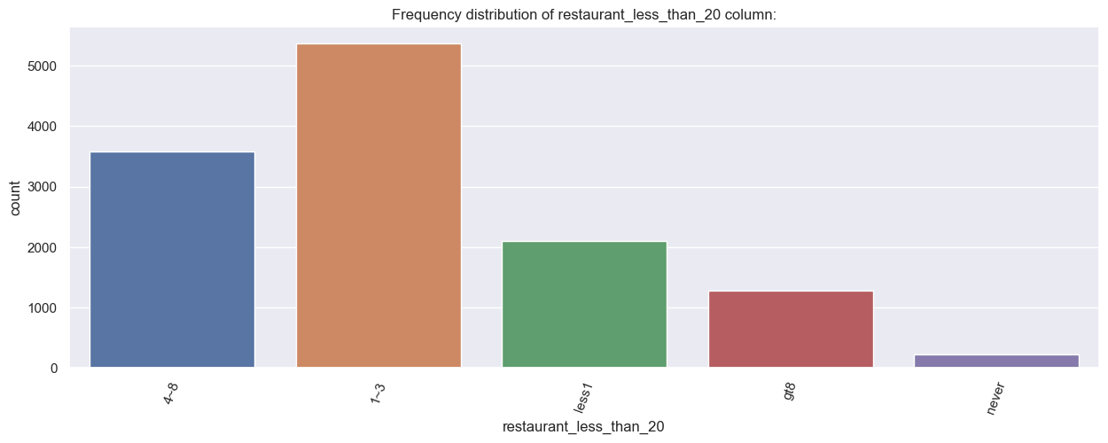
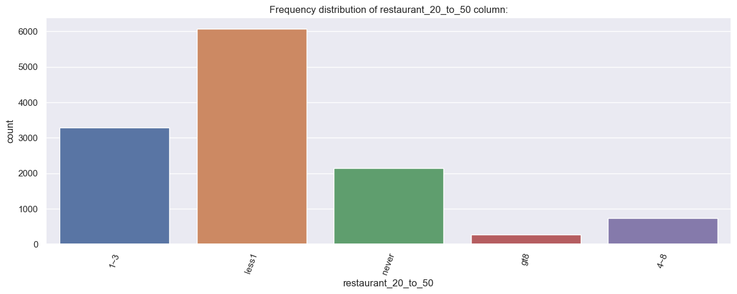
Bar, Coffee House, Carry Away Restaurant(<$20), Restaurant ($20-$50)
All these features are divided into same categories based on number of times customer visits these places.
I have used Label encoder for these features.

Slide 12
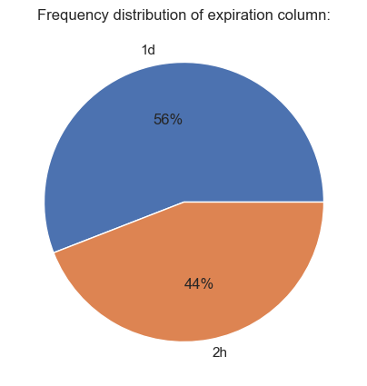
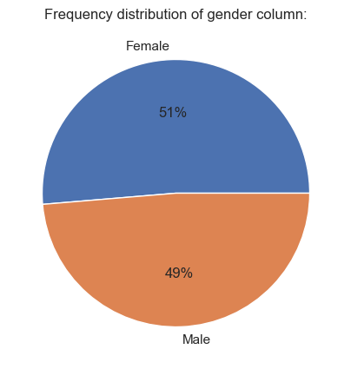
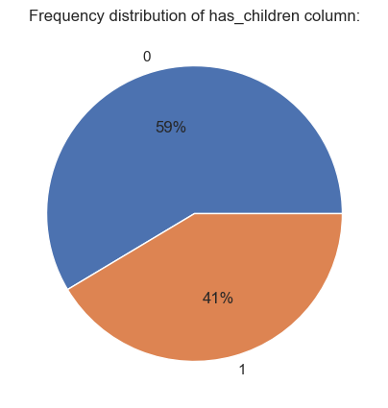
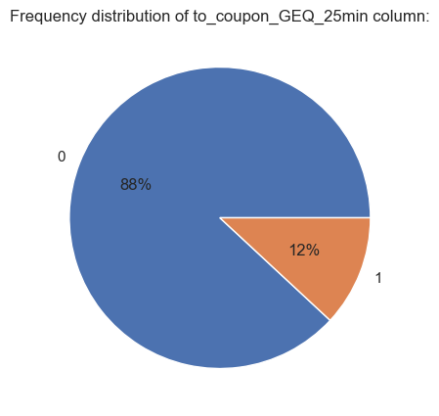
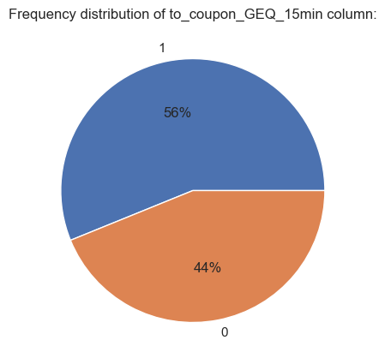
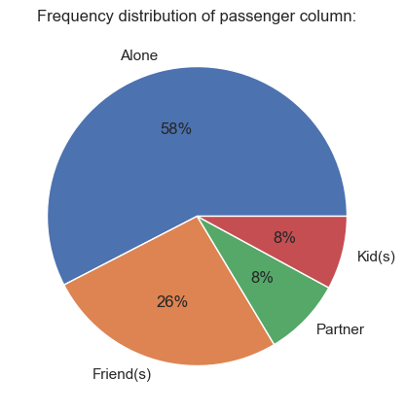
Distribution of other columns

Slide 13
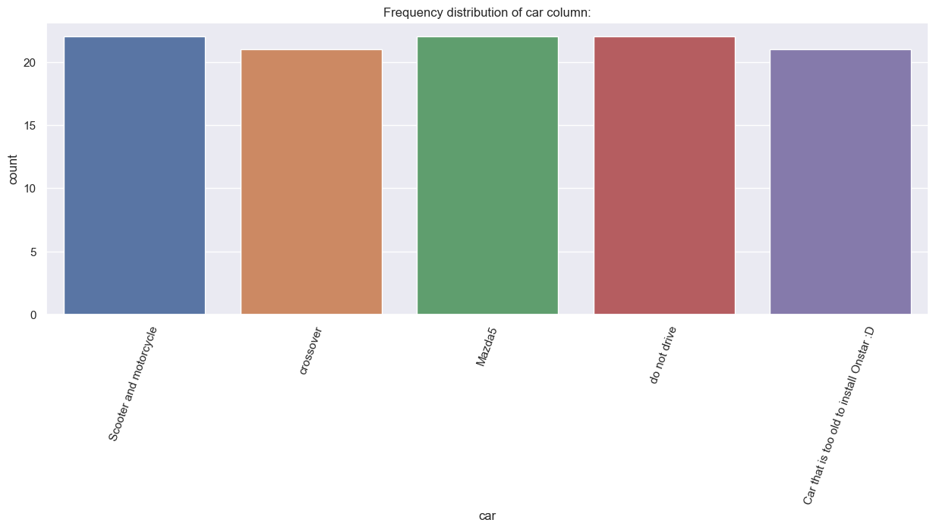
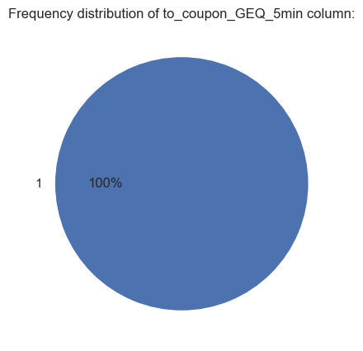
Car & GEQ 5min
The car column has the description of the vehicle of the customer but it has 99.15% of missing values.
The GEQ 5min column had only single value for all observation.
Dropped both of these columns.

Slide 14
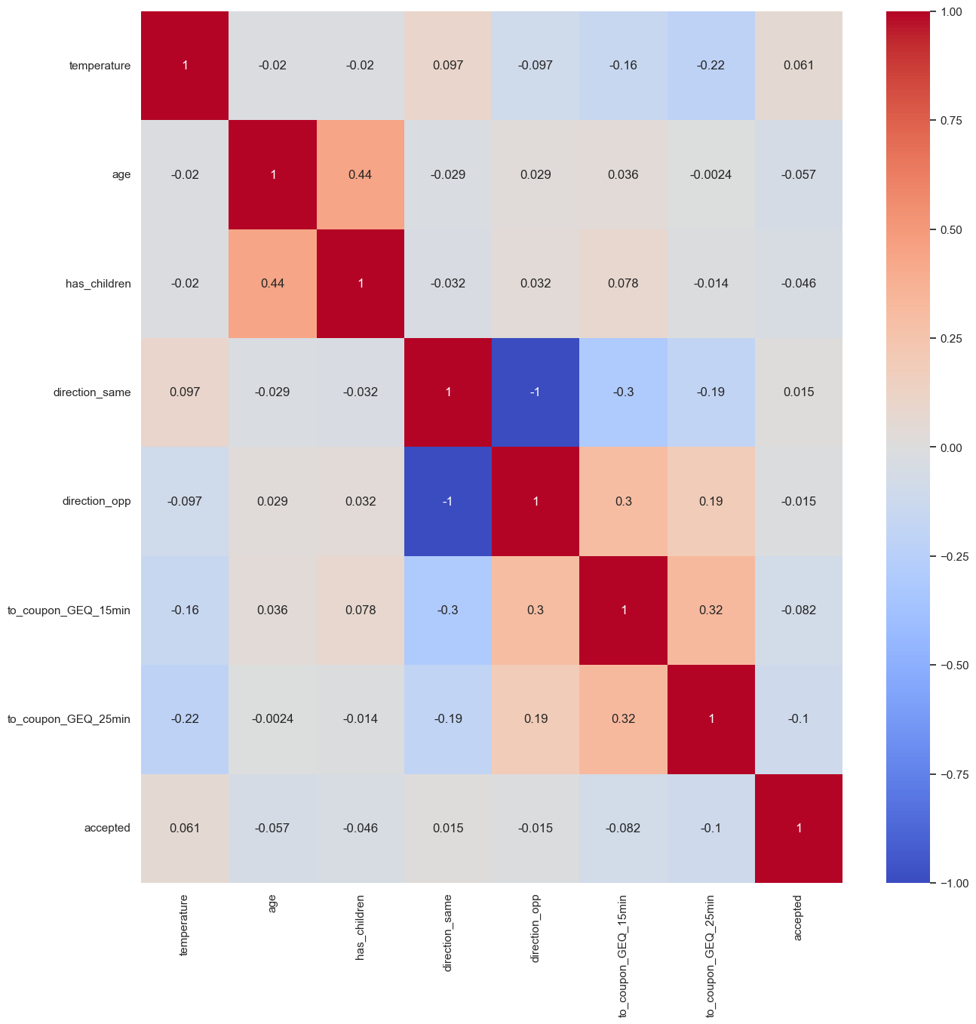
Direction Opposite and Direction Same are Correlated
If the customer is not going towards a place he is going in opposite direction.
These two columns are highly correlated.
I dropped direction opposite feature.

Slide 15
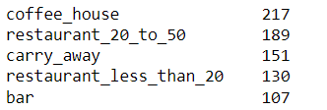
Missing Values and Scaling.
Used KNN imputer to impute the missing values.
KNN imputer looks for similar examples in dataset and imputes values based on most frequent value.
Scaling of dataset didn’t affect the accuracy much since the values are not very far apart.
But used standardization because it was slightly performing better as compared to unscaled and normalized data.

Slide 16
Machine Learning Models

Slide 17
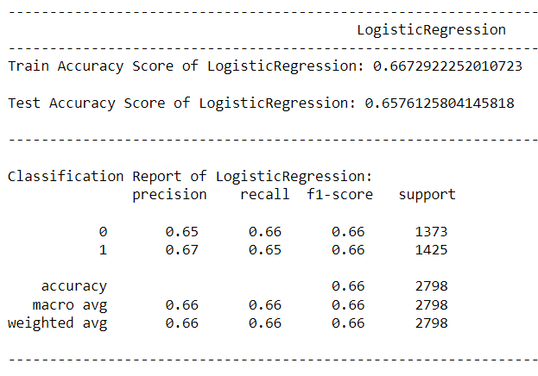
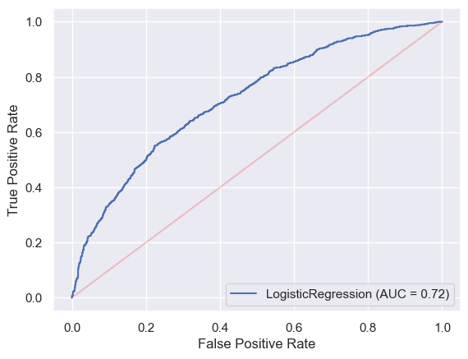
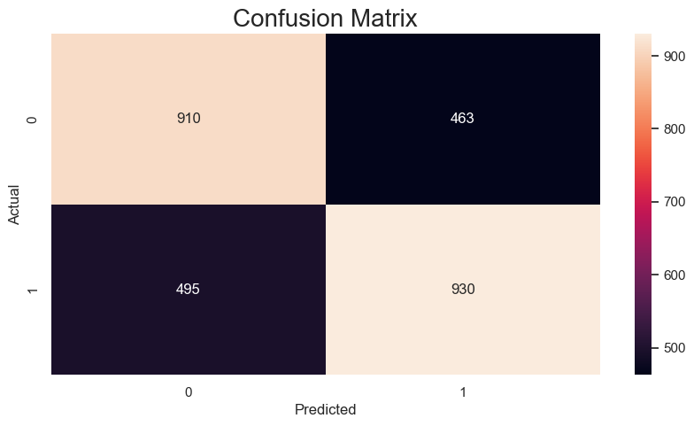
Logistic Regression
We are getting 66.7% train accuracy and 65.7% Test accuracy.
Precision and Recall is at 66%.
AUC is 72%.
ROC curve is ok.
Overall model is ok.

Slide 18
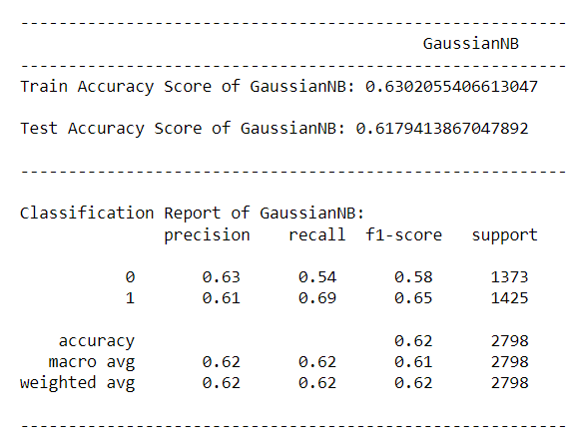
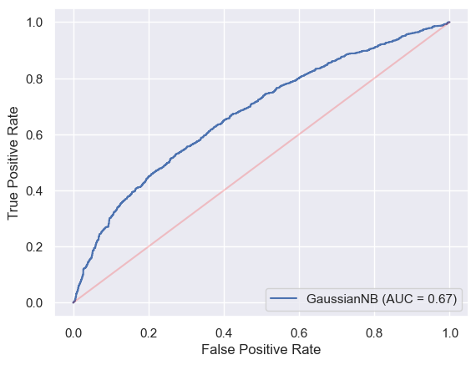
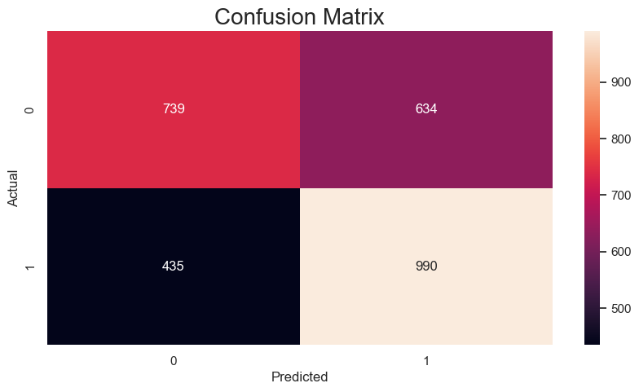
Naive Bayes Classification
We are getting 63% train accuracy and 61.7% Test accuracy.
Precision and Recall is at 62%.
AUC is 67%.
ROC curve is ok.
Overall model is ok.

Slide 19
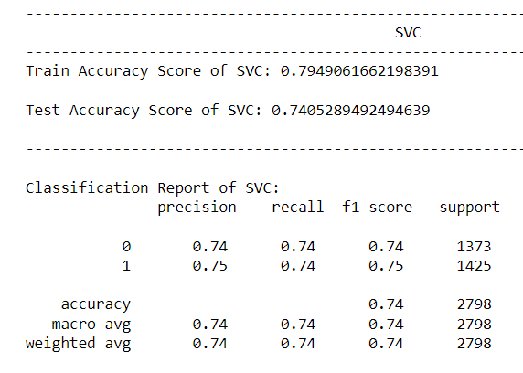
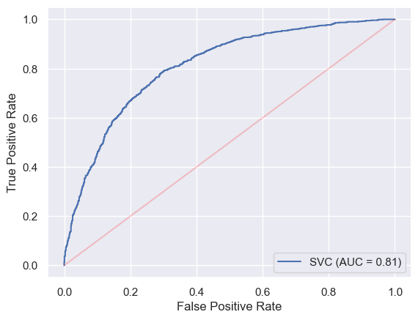
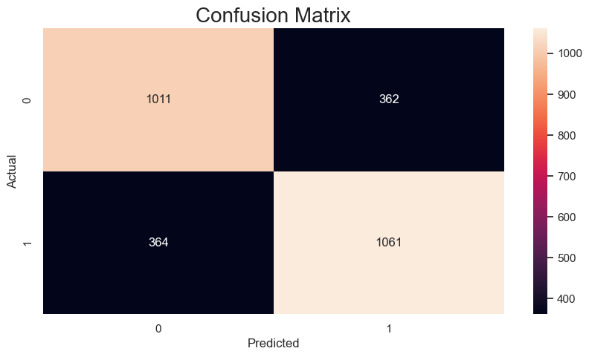
Support Vector Machine Classification
We are getting 79.5% train accuracy and 74% Test accuracy.
Precision and Recall is at 74%.
AUC is 81%.
ROC curve is good.
Overall model is good.

Slide 20
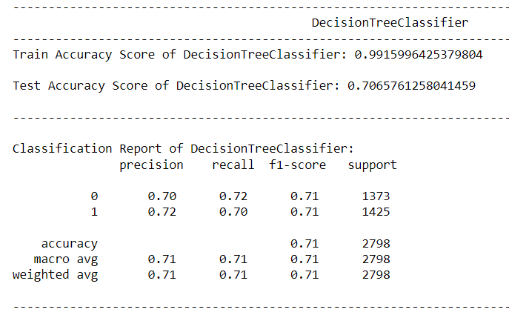
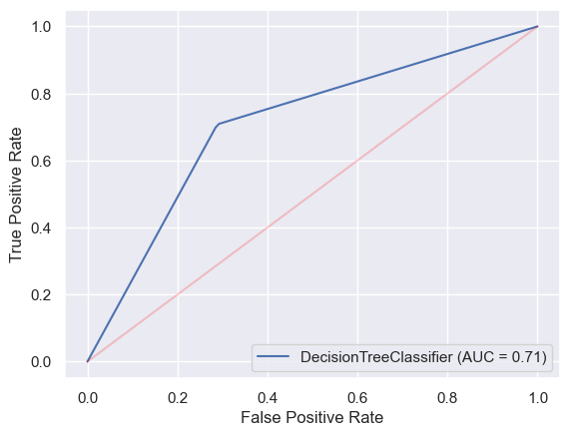
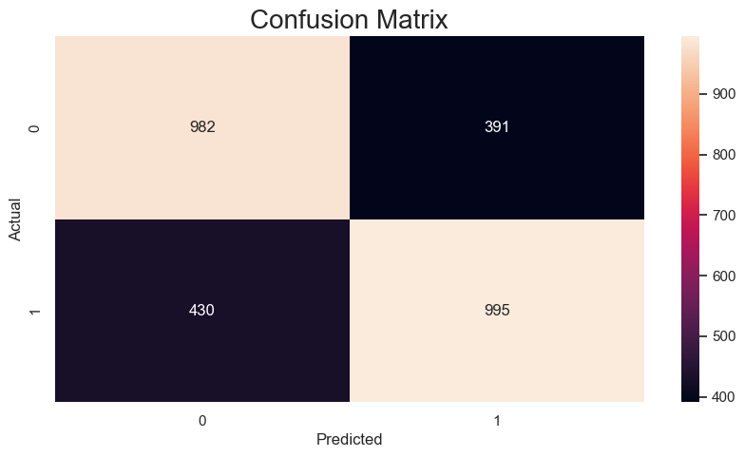
Decision Tree Classifier
We are getting 99.2% train accuracy and 70.6% Test accuracy. Model is overfitting.
Precision and Recall is at 71%.
AUC is 71%.
ROC curve is ok.
Overall model is ok.

Slide 21
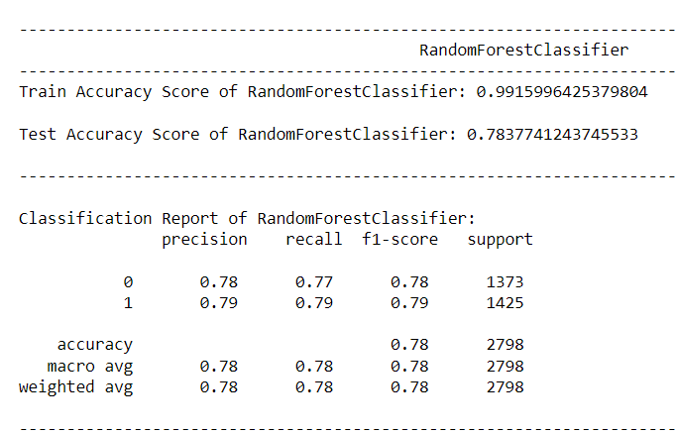
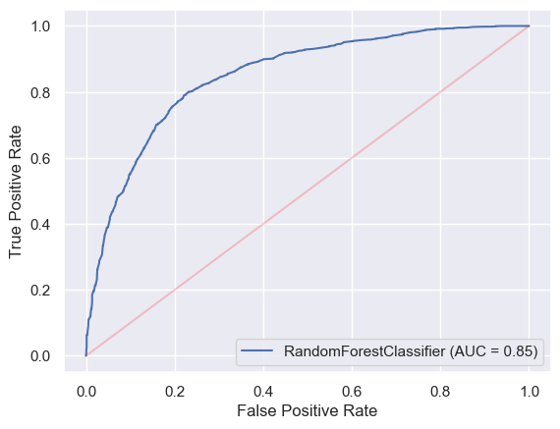
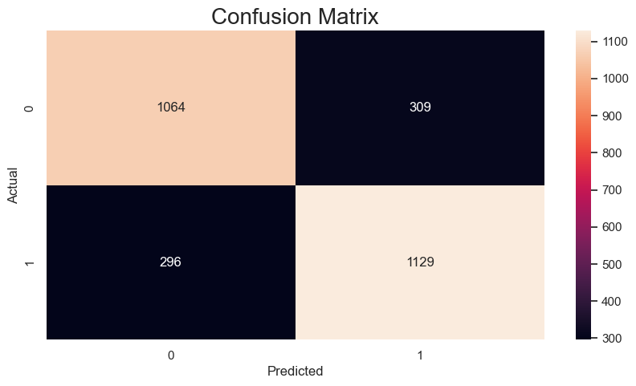
Random Forest Classifier
We are getting 99.2% train accuracy and 78.4% Test accuracy. Model is overfitting.
Precision and Recall is at 78%.
AUC is 85%.
ROC curve is good.
Overall model is good.

Slide 22
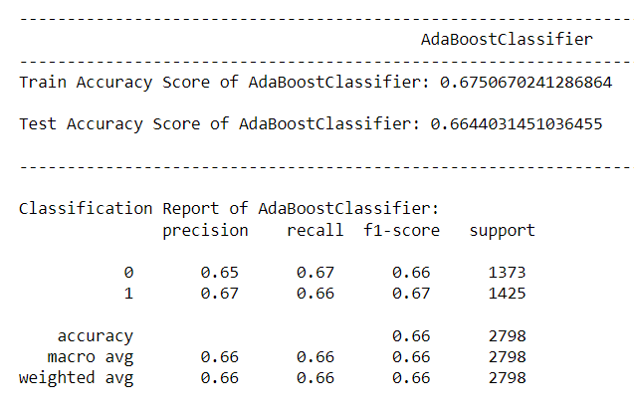
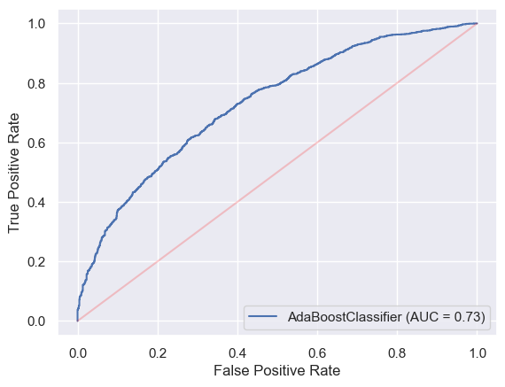

Ada Boost Classifier
We are getting 67.5% train accuracy and 66.4% Test accuracy.
Precision and Recall is at 66%.
AUC is 73%.
ROC curve is ok.
Overall model is ok.

Slide 23



Gradient Boosting Classifier
We are getting 73.8% train accuracy and 71.9% Test accuracy.
Precision and Recall is at 72%.
AUC is 79%.
ROC curve is good.
Overall model is good.

Slide 24



XGBoost Classifier
We are getting 89.9% train accuracy and 77.3% Test accuracy.
Precision and Recall is at 77%.
AUC is 85%.
ROC curve is good.
Overall model is good.

Slide 25

Comparison of Models.
Random Forest and XGBoost Classifier are performing better.
But we see these models are Overfitting.
Used Hyper Parameter Tuning with GridSearchCV and Cross Validation to improve the models.
By using Hyper Parameter Tuning XGBoost was performing better than Random Forest. So created Final Model using XGBoost Classifier.

Slide 26



Final Model – XGBClassifier
Accuracy – 77.4%
Precision and Recall – 77%
AUC – 86%.
ROC is good.

Slide 27
Conclusion
With 77.4% Accuracy we can now predict if the customer will accept the coupon or not.
Random Forest and XGBoost were performing better than other models.
Random Forest was Overfitting.
We have used XGBoost as our final model.

Slide 28
Thank You

